Slide 1
An Intelligent Car Crash Recognition System
Leveraging Deep Learning with Edge and Cloud
Integration
Guided by: Mrs.K.Menaka ,AP/CSE
Team Members:
S.Joshika(921821104015)
S.Swetha(921821104044)
R.Venniladevi(921821104047)

Slide 2
Objective:
The goal of this system is to create an autonomous accident detection mechanism that:
Real-time Detection: Identifies accidents as soon as they happen using video footage
Instant Alerts: Triggers sound alarms and sends immediate notifications via email.
Image Attachment Captures and shares accident images, allowing emergency teams to respond faster.
The system integrates modern technologies like YOLOv8 (for object detection), email protocols, and sound notifications for a comprehensive solution

Slide 3
Problem Statement:
Accidents on roads are one of the leading causes of fatalities and injuries worldwide.
While traditional surveillance cameras and systems can monitor traffic, they often lack real-time intervention capabilities.
Immediate response to accidents can prevent further damage and save lives.
However, the current systems are either manual or delayed, meaning the incidents often go unnoticed for longer periods.
This problem calls for a system that not only detects accidents but can also act immediately to notify authorities and emergency responders.

Slide 4
Existing System
Conventional accident detection systems primarily rely on cloud computing, which leads to significant response delays due to network dependency and high bandwidth usage. These systems lack real-time processing capabilities, resulting in late emergency service notifications. Additionally, centralized processing often fails in low-connectivity regions and cannot efficiently handle the increasing data from modern vehicles and surveillance systems.
Disadvantage
High latency in accident detection due to reliance on cloud-based processing.
Heavy bandwidth consumption, as all data must be sent to the cloud.
Dependence on stable network connectivity, which may not be available in remote or rural areas.
Slower emergency response, reducing the chance of timely aid and increasing the risk to lives.

Slide 5
Proposed System
Input Feed: Accepts video footage or live camera to monitor traffic scenes.
Object Detection: Uses YOLOv8 to detect vehicles (cars, bikes, buses, trucks) in each frame.
Collision Detection: Identifies accidents by checking overlaps between vehicle bounding boxes.
Alert System: Triggers a sound alarm and sends an email with the accident image when a collision is detected.
Visualization: Displays real-time video with detection boxes and logs accident images for review.

Slide 6
Advantages:
Real-time accident detection and alerting using edge processing.
Reduces network dependency and latency with on-device computation.
Immediate alerts via sound and email improve emergency response times
Efficient data handling suitable for both urban and remote areas.
Visual logs aid in reviewing and verifying accidents quickly.

Slide 7
Software Required:
YOLOv8 (Object Detection): YOLOv8 is a state-of-the-art, deep learning-based object detection algorithm that provides real-time performance for detecting objects in video feeds, such as vehicles (cars, motorcycles, buses, trucks).
OpenCV (Video Processing): OpenCV is used for handling the video feed, processing frames, and drawing bounding boxes around detected vehicles.
Python (Programming Language): Python is the primary language used to develop the entire system due to its rich ecosystem of libraries and ease of use for deep learning.
smtplib (Email Notifications): The Python smtplib library is used to send emails whenever an accident is detected, attaching the accident image for context
.
playsound (Sound Alerts): This library plays an alarm sound whenever an accident is detected, providing real-time audio feedback.

Slide 8
Hardware Required:
CPU Intel Core i3 / i5 (7th Gen or newer): Handles object detection and frame processing
RAM: 8GB Needed for handling video frames, models, and libraries
Storage: 128GB (HDD or SSD) Stores video data, YOLOv8 model files, and logs
Operating System: Windows 10 / 11 or Ubuntu 20.04+ Compatible with Python, OpenCV, YOLOv8
Camera: Built-in Webcam or USB Webcam For video input
Speaker: Built-in or External For alarm sound via playsound
Internet: Wi-Fi or Ethernet Required for sending email alerts using smtplib

Slide 9
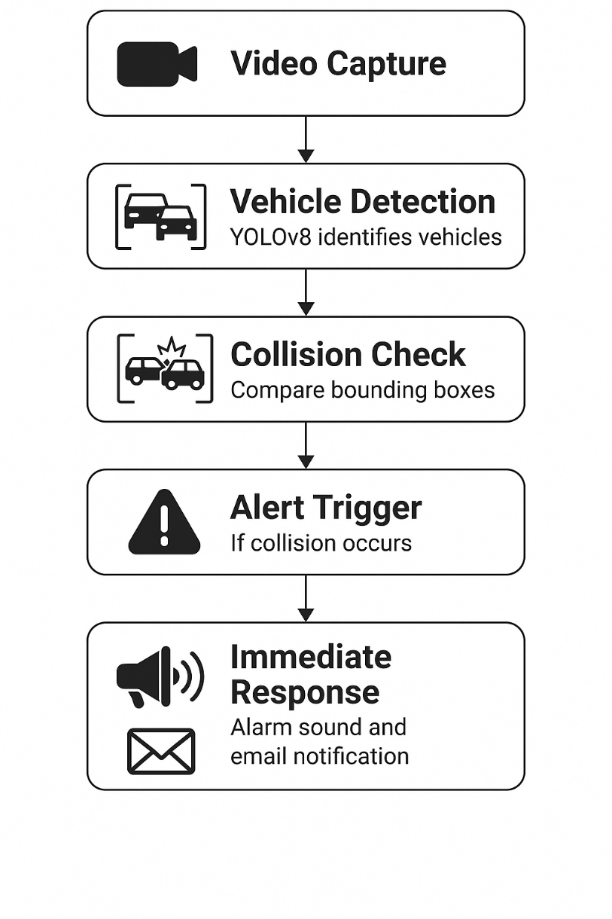
System Architecture:

Slide 10
Input: The system uses a video feed as input, capturing real-time footage from traffic cameras.
YOLOv8 Detection: YOLOv8 processes the video, identifying vehicles in the frame by drawing bounding boxes around them.
Collision Detection: The system checks if the detected vehicles are colliding (using centroid overlap of bounding boxes).
Alert Mechanism: If a collision is detected, it triggers sound and sends an email with the accident image.
Output: An email with the attached accident image is sent to the designated recipient, and an audio alert is played for immediate response.

Slide 11
Output:
Accident Detection Image: A snapshot of the detected accident, which is sent via email.
Sound Alert: An audio cue indicating that an accident has occurred.
Email Notification: The email will contain the accident image and details, allowing emergency responders to take action quickly.

Slide 12
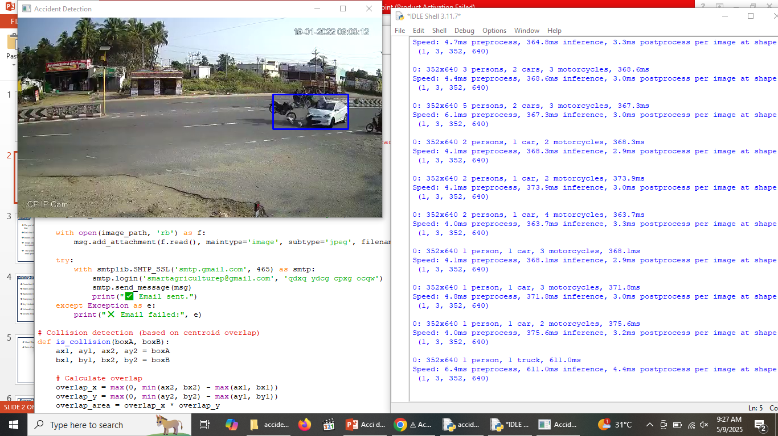
Fig1: A screenshot of code accident detection

Slide 13
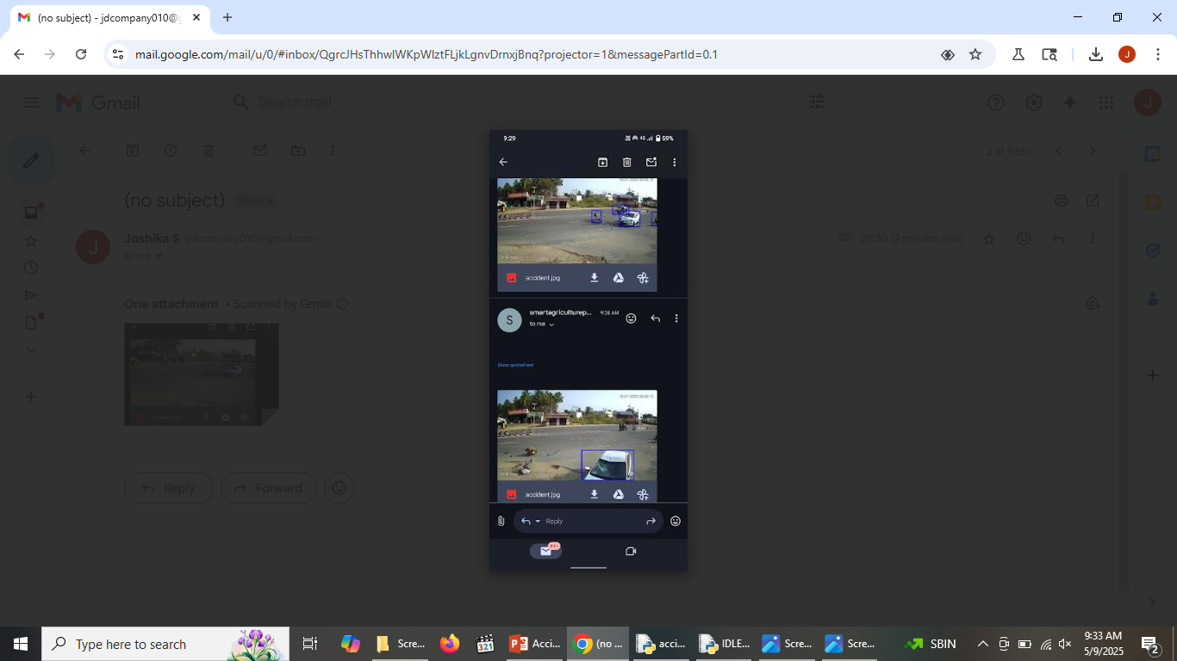
Fig2: A screenshot of accident detected mail sent

Slide 14
Future Work:
Time Smart City Integration: The system can be integrated into smart city frameworks to monitor and respond to accidents in urban environments.
Vehicle Registration: Integration with vehicle databases to send notifications to vehicle owners.
Further Optimizations: More object detection classes (e.g., pedestrians, traffic lights) can be added for a broader scope of detection.
IoT Integration: The system could eventually trigger traffic lights or communicate directly with emergency vehicles to speed up response .

Slide 15
Conclusion:
The proposed Edge–Cloud accident detection system effectively addresses latency, bandwidth, and real-time responsiveness issues seen in cloud-only models.
By leveraging a lightweight 2D CNN on edge nodes, the system processes data locally, reducing response time and network usage.
Achieved high detection accuracy (95.91%) with excellent Precision, Recall, and F1-score (0.9574 each).
Simulation results (iFogSim) show up to 60% latency reduction compared to traditional cloud-only setups.
Integrating this framework with real-world emergency services (e.g., Twilio API) enhances its practical deployment potential.

Slide 16
Literature survey:
S. No | Paper Title / Topic | Authors | Method / Model Used | Key Contributions | Limitations
1 | Traffic Accident Detection and Classification in Videos Based on Deep Network Features | Afreen et al. [4] | CNN (GoogLeNet, AlexNet, VGGNet) | Compared multiple CNNs for accident detection using video data | Focused on cloud-based processing
2 | Accident Detection Using Convolutional Neural Networks | Ghosh et al. [5] | CNN | Achieved 95% accuracy; correlated accidents with population and income data | Did not use edge computing
3 | Fog-Assisted Elephant Corridor Detection Over Railway Track | Mondal et al. [6] | DL with fog computing | Detected elephant crossings to prevent train accidents | Not related to car accidents
4 | Vehicular Accident Detection and Rescue Alert System Using IoT with CNN | Sathya et al. [7] | IoT + CNN | Real-time accident detection with alert system | Limited to IoT integration
5 | CPS-Based Social Distancing Model Using Edge and Fog | Mondal et al. [8] | Edge & Fog Computing | Social distancing monitoring system | Not relevant to accident detection

Slide 17
6 | Deep Learning with Edge Computing: A Review | Chen and Ran [9] | Survey | Reviewed DL applications in edge computing | General-purpose review
7 | DL for Edge Computing Applications: A Survey | Wang et al. [10] | Survey | Comprehensive survey of DL techniques in edge computing | No focus on accident detection
8 | Energy-Efficient Task Offloading in Mobile Edge for Surveillance | Mondal et al. [11] | Binary & Partial Offloading | Proposed energy-efficient task offloading strategies | General surveillance, not accident-specific
9 | Visitor Identification with YOLO in Edge Environment | Mondal et al. [14] | YOLO + Edge Computing | Improved latency and network usage using YOLO | Not focused on accidents
10 | Learning IoT in Edge: Deep Learning for the Edge Environment | Li et al. [15] | DL + Task Offloading | Optimized DL performance via edge offloading strategies | No accident detection application

Slide 18
Reference papers:
Afreen et al. (2023) used deep learning models like GoogLeNet, AlexNet, and VGGNet to detect and classify road accidents from videos. Their work focused entirely on using cloud-based systems for processing.
Ghosh et al. (2019) developed a CNN-based accident detection model that achieved around 95% accuracy. They also studied how accident rates relate to population and income levels.
Mondal et al. (2023) proposed a fog-computing-based deep learning model to detect elephants near railway tracks to prevent accidents. Although not vehicle-focused, it demonstrated deep learning in safety systems.
Sathya et al. (2023) designed a vehicular accident detection and alert system using IoT devices combined with CNNs to trigger rescue alerts in real time.
.

Slide 19
Thank You !!!

